Slide 1



hospital DB
View in Power BI
Last data refresh:
7/25/2024 7:11:27 AM UTC
Downloaded at:
7/25/2024 7:20:43 AM UTC

Slide 2
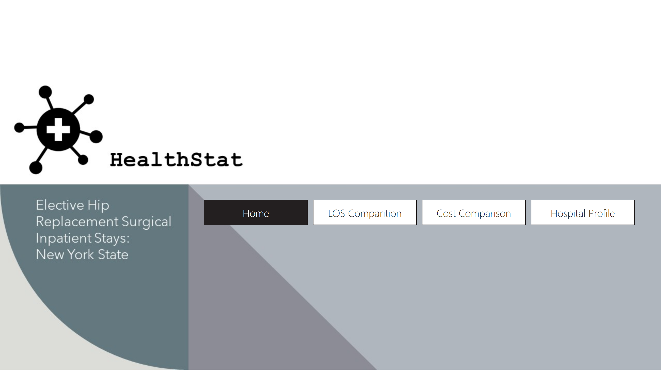
Home
Notes:
pageNavigator
No alt text provided

Slide 3
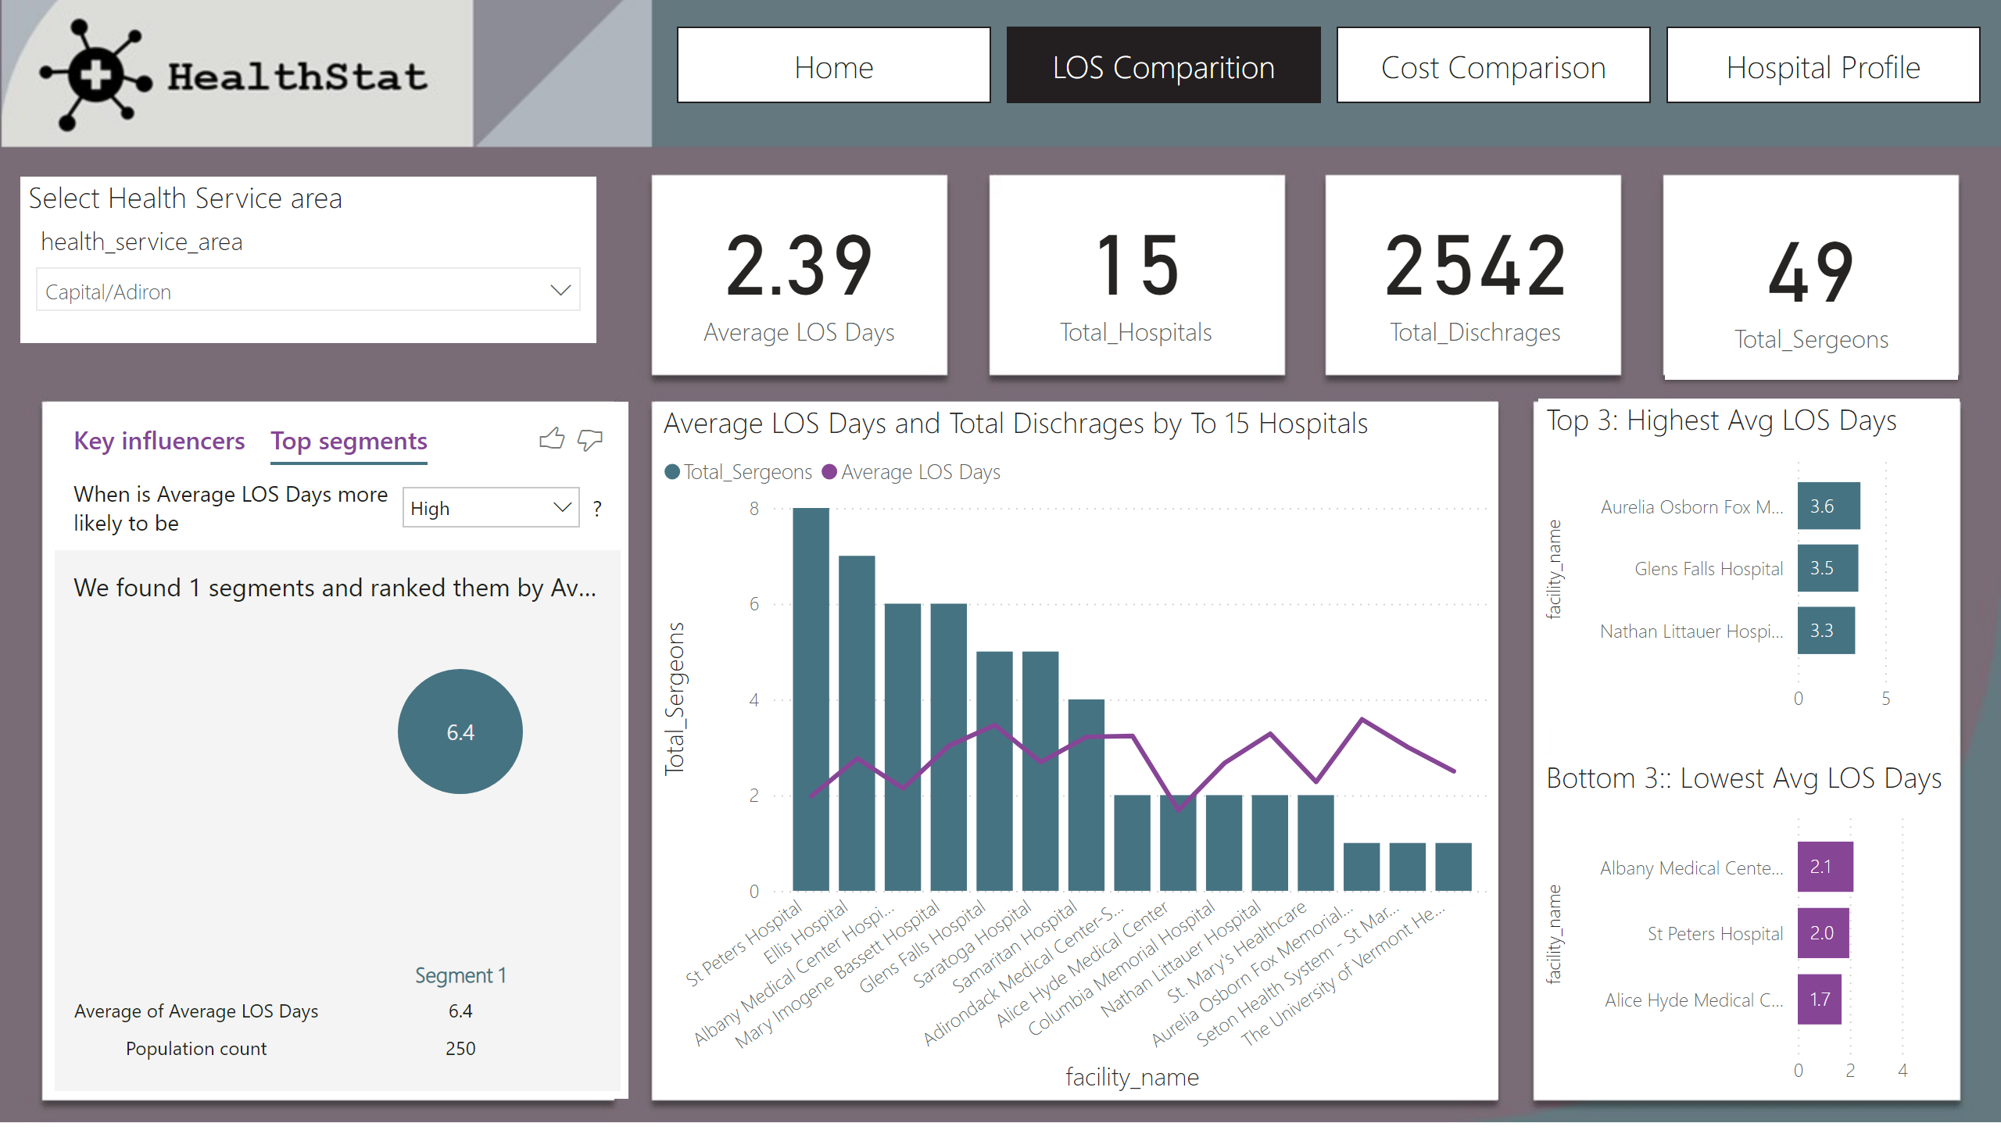
LOS Comparition
Notes:
Average LOS Days and Total Dischrages by To 15 Hospitals
No alt text provided
card
No alt text provided
slicer
No alt text provided
Select Health Service area
No alt text provided
Top 3: Highest Avg LOS Days
No alt text provided
keyDriversVisual
No alt text provided
Bottom 3:: Lowest Avg LOS Days
No alt text provided
card
No alt text provided
card
No alt text provided
card
No alt text provided
pageNavigator
No alt text provided

Slide 4
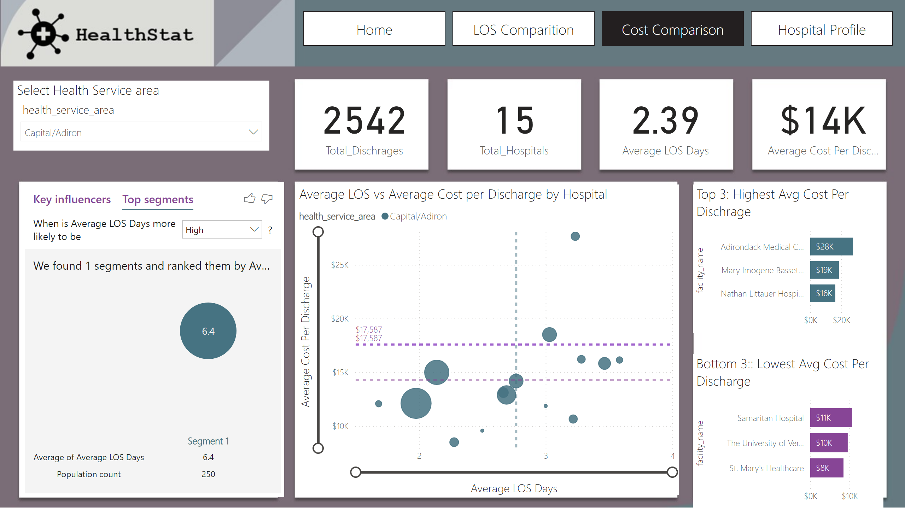
Cost Comparison
Notes:
Average LOS vs Average Cost per Discharge by Hospital
No alt text provided
Select Health Service area
No alt text provided
Top 3: Highest Avg Cost Per Dischrage
No alt text provided
Bottom 3:: Lowest Avg Cost Per Discharge
No alt text provided
card
No alt text provided
card
No alt text provided
card
No alt text provided
card
No alt text provided
keyDriversVisual
No alt text provided
pageNavigator
No alt text provided

Slide 5
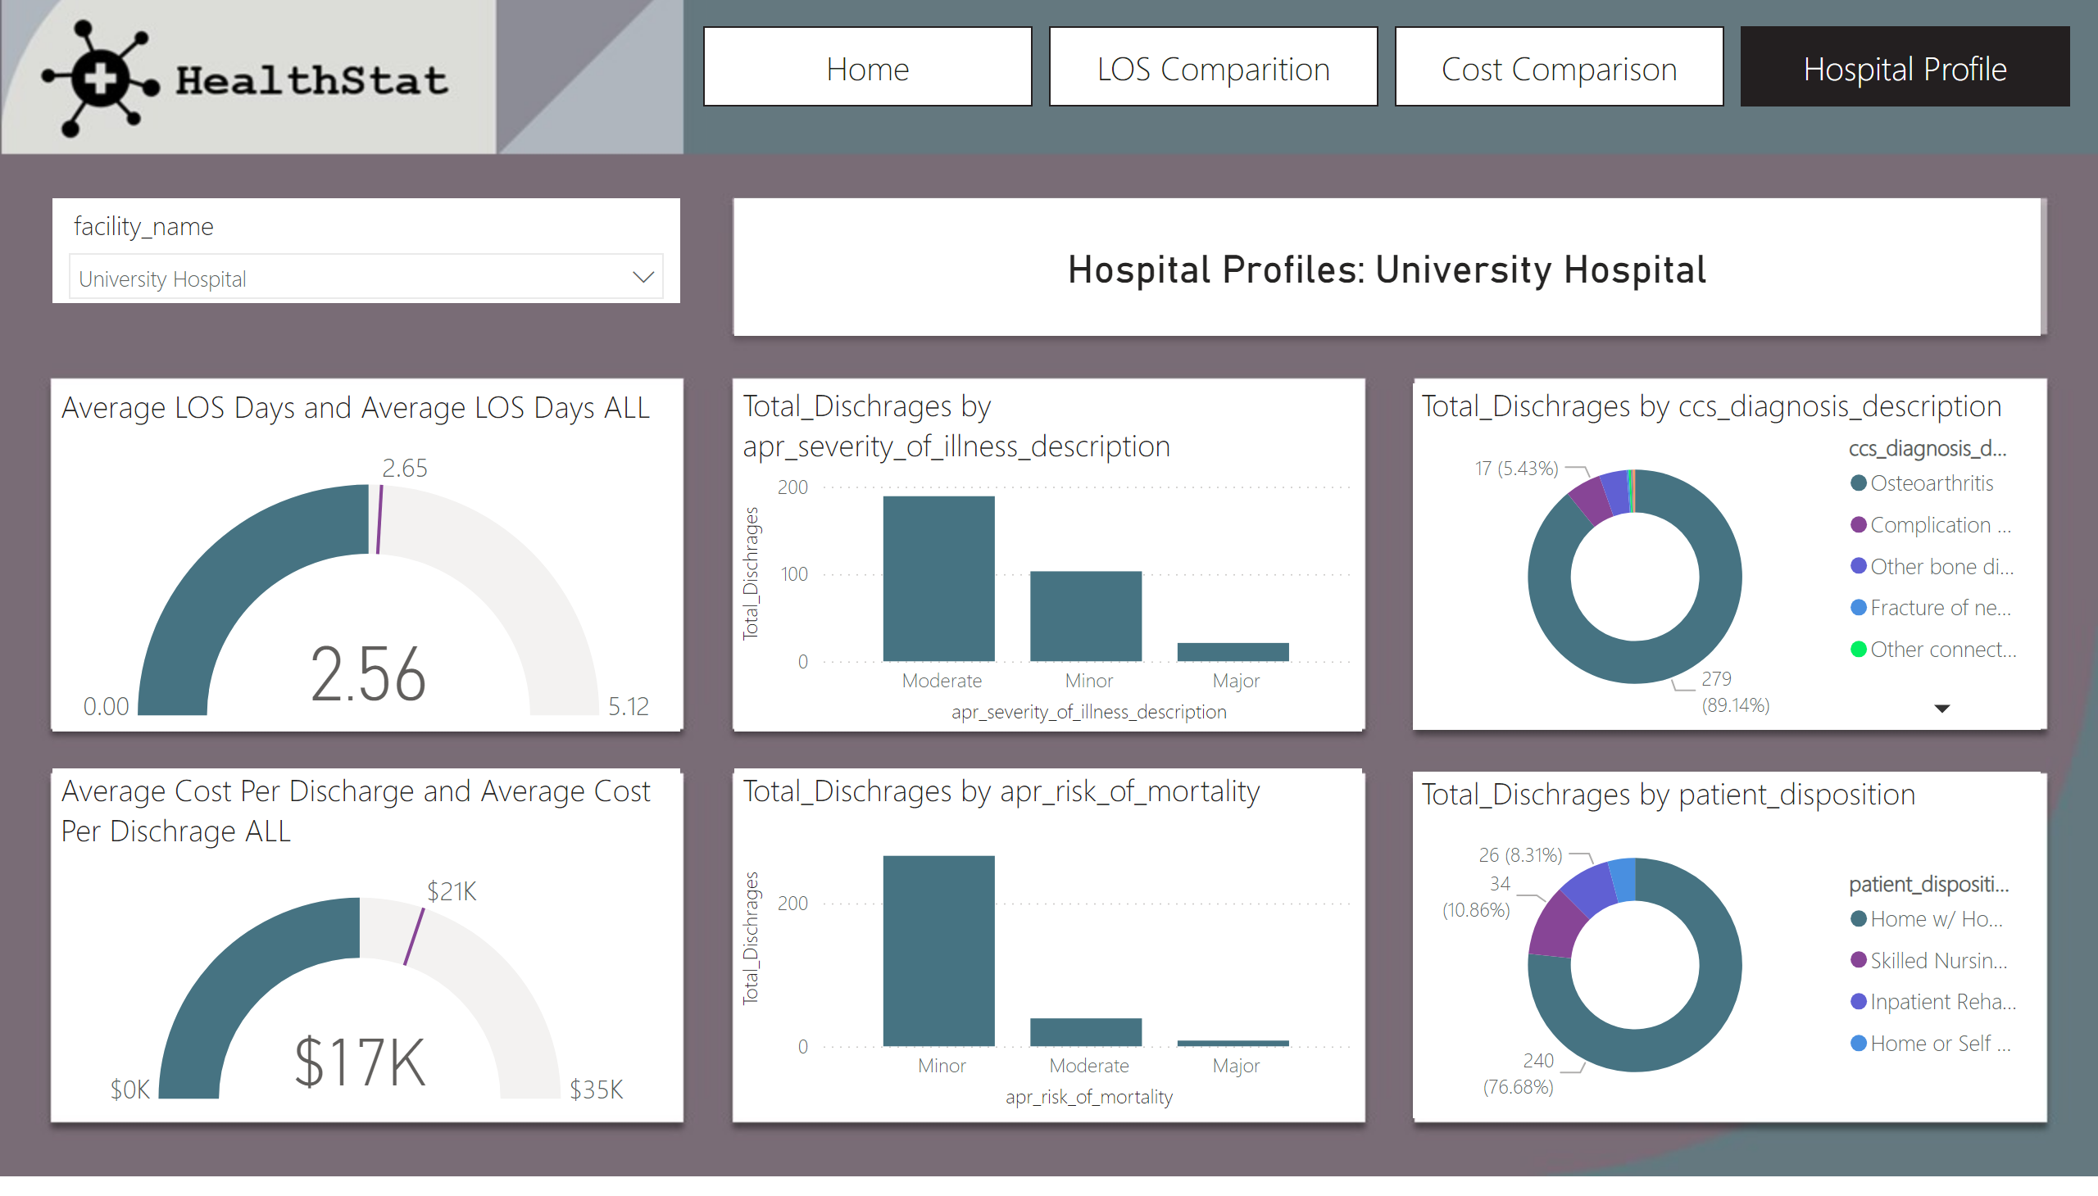
Hospital Profile
Notes:
gauge
No alt text provided
gauge
No alt text provided
columnChart
No alt text provided
columnChart
No alt text provided
donutChart
No alt text provided
donutChart
No alt text provided
Select Hospital Name
No alt text provided
card
No alt text provided
pageNavigator
No alt text provided

